Slide 1

Development of a Web-Based Smart Store Management System for Retail Store
Yu Yue 1001956834
Supervisor: Asst. Prof. Dr. Shayla Islam
Second Marker: Asst. Prof. Dr. Chloe Thong Chee Ling

Slide 2
Table of Content
Introduction
Observations & Comparisons of existing Systems
Problem Statement
Aim
Objectives
Method
System Development Life Cycle
Results and Findings
System Demonstration
Feature Code
Conclusion
Future Works
References

Slide 3
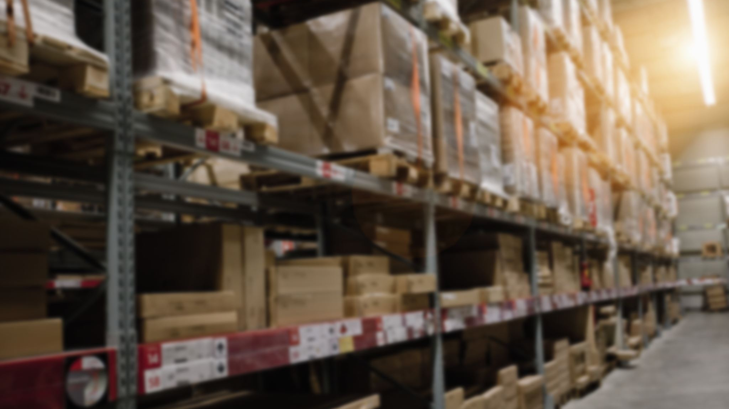
Introduction
Today, stores are all around everyone. It is a traditional retail business organization, while the modern retail business model is gradually transforming into the new retail. It is a business model derived from the new era, with consumers as the core and data and information technology as the retail format. This project aims to design and develop a web-based smart shop management system application to provide solutions for the management of retail businesses, to help retail shop managers improve the efficiency and performance of managing their shops, and to effectively improve the adaptability of their businesses to the online and offline retail business environment, which will be the focus of this research and exploration [1].

Slide 4
Background
The retail industry has a long history of development. By studying the evolution of the global retail industry, it can be found that the goal of retail companies is to obtain more customer traffic, higher purchase rates and higher customer loyalty at lower costs, and people move from physical stores to the Internet and from the Internet to mobile Internet [2]. The industry can only get the most efficient customer traffic by making corresponding changes.
With the rapid development of network information technology, emerging forms of online retailing appear in people's lives, and the establishment of Alibaba in China in 1999, the online retailing model continues to influence and change the shopping behavior of consumers, while the physical retail industry still has many problems such as unreasonable resource allocation and high costs in the development process due to the lack of relevant experience [3]. Therefore, retail enterprises should fully understand the online and offline retail environment and develop a reasonable marketing model based on this, which is the main problem facing the development of retail enterprises at present.

Slide 5
Observations & Comparisons of existing Systems
No | System Title | Introduction | Advantage Features
1 | IQmetrix | iQmetrix provides integrated POS, retail management and software solutions that help wireless, repair and specialty retailers create an outstanding customer experience [4]. | 1. Scalable 2. Easy to use 3. Advanced Security 4. No more outdated technologies
2 | Springboard | Springboard Retail's point-of-sale and retail management software provides retailers with data to support more rational sales strategies [5]. | 1. Data driven 2. Built-in flexibility 3. Easy Export
3 | Retail Pro | Retail Pro is the global leader in retail management software, known worldwide for its rich functionality, cross-country capabilities, and unmatched flexibility [6]. | 1. Internationalization 2. Mining complex data 3. Inventory management
4 | ChainDrive | ChainDrive is composed entirely of retail process components and is a single-source omnichannel software on which users can base their management activities and implement many operations [5]. | 1. Mobile Friendly 2. Loss Prevention 3. Employee Productivity 4. Track Store Performance 5. Using Data Mining Techniques

Slide 6

Problem Statement
High operation and management costs of traditional retail stores [7].
The limited amount of customers that can be reached in traditional offline retail stores [8].
Traditional retail stores are difficult to aggregate merchandise statistics [9].
Traditional retail stores are difficult to manage inventory [10].

Slide 7

Aim
The aim of this project is to design and develop a web-based smart store management system application. With the help of this application, it helps retail store managers to improve management efficiency and performance.

Slide 8
Objectives
1. To study the current existing store management system and determine the strengths and weaknesses of the current system.
2. To develop a web-based smart store management system application:
a) To design a store management system that combines online and offline to solve the high operating cost of retail stores.
b) To develop store distribution, express distribution, and other functions for retail stores to solve the limited number of customers in offline retail stores.
c) To develop the function of online real-time entry and update of inventory information for the system to solve the statistical problem of commodity information in traditional retail stores.
d) To develop functions for the system to purchase, return and exchange goods from suppliers, solving the procurement management problems of traditional retail stores.
3. To evaluate the performance of the developed web-based smart store management system.

Slide 9
Method
Literature Review
User Requirement Gathering
SDLC Waterfall Model
User Acceptance Test

Slide 10
User Requirement Gathering
In order to obtain user requirements, data will be collected through a questionnaire distributed via Google Forms.
110 respondents are invited to fill in the questionnaire and the sample will include retail shop managers or shop owners from different countries or regions.
A large amount of information will be collected to determine the functional requirements of the application to be developed.
The survey was posted on social media platforms such as Facebook and Twitter.

Slide 11
System Development Life Cycle
Requirement Analysis
System Design
Implementation
Testing
Deployment
Maintenance

Slide 12
Results and Findings
Statement | Strongly Disagree | Disagree | Disagree | Agree | Strongly Agree
I find it useful to manage product inventory information through this store management application |  |  |  |  | 100%
With this Smart Store management system, I can manage my stores more effectively |  |  |  |  | 100%
Smart Store has added online channels to sell products, opening up new markets and customers for me |  |  |  | 6.2% | 93.8%
The good user interface motivates me to use this Smart Store management application |  |  |  | 6.2% | 93.8%
Using this store management application to manage the store is stress-free and it allows me to manage the store more easily |  |  |  | 6.2% | 93.8%
I don't need a lot of technical knowledge to use this Smart Store management application |  |  |  |  | 100%
Using this Smart Store application can reduce the capital cost and labor cost of my store |  |  |  | 6.2% | 93.8%
Smart Store gives me a very good experience of using it |  |  |  |  | 100%
I find it very convenient and easy to manage the store through this store management application |  |  |  |  | 100%
With this store management application, I can quickly and easily know the status of my store |  |  |  |  | 100%

Slide 13
System Demonstration

Slide 14
Feature Code

Slide 15
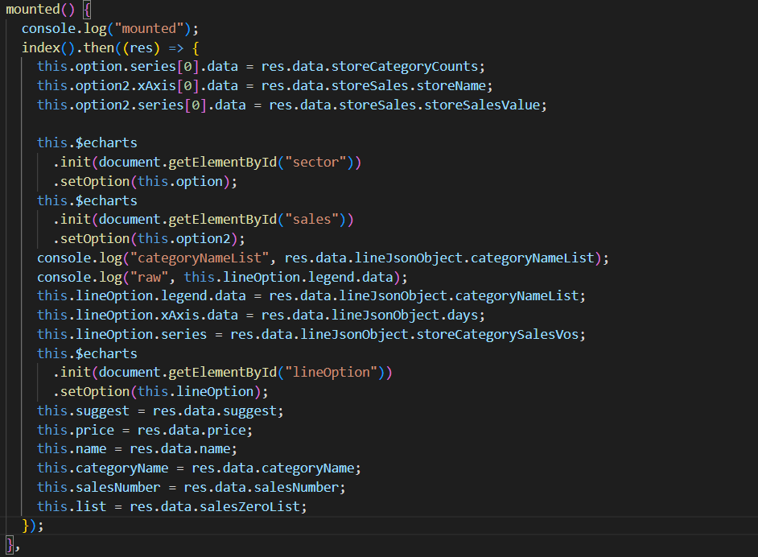
Store Analysis and Diagnosis

Slide 16
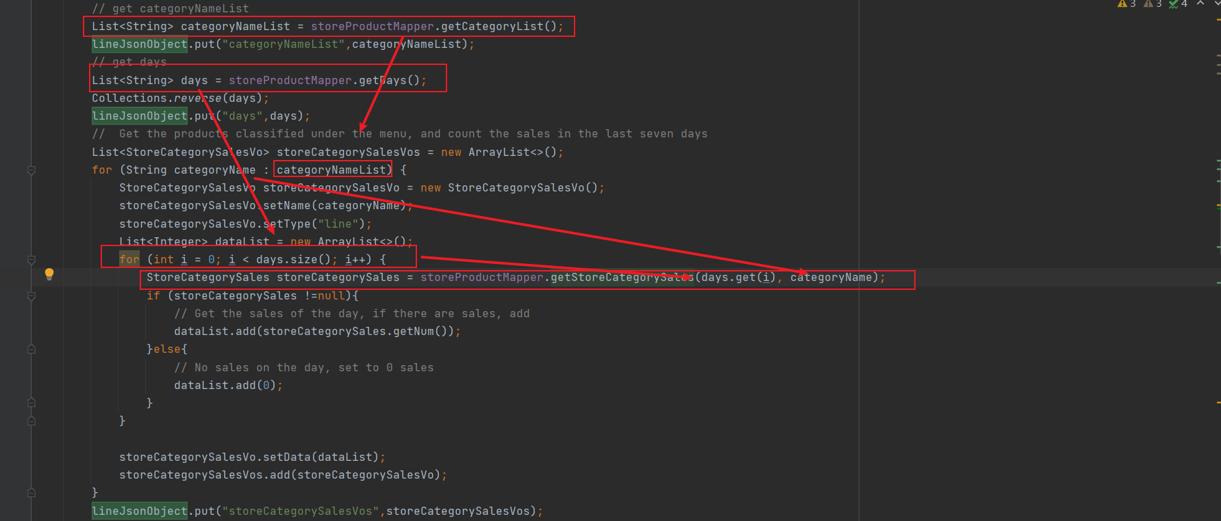
Store Sales Statistics

Slide 17
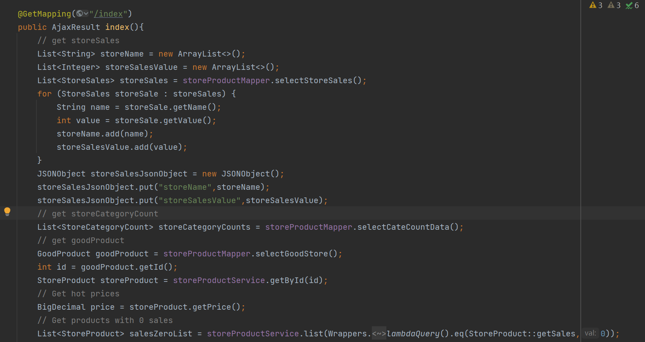
Statistics of Better Selling Items

Slide 18
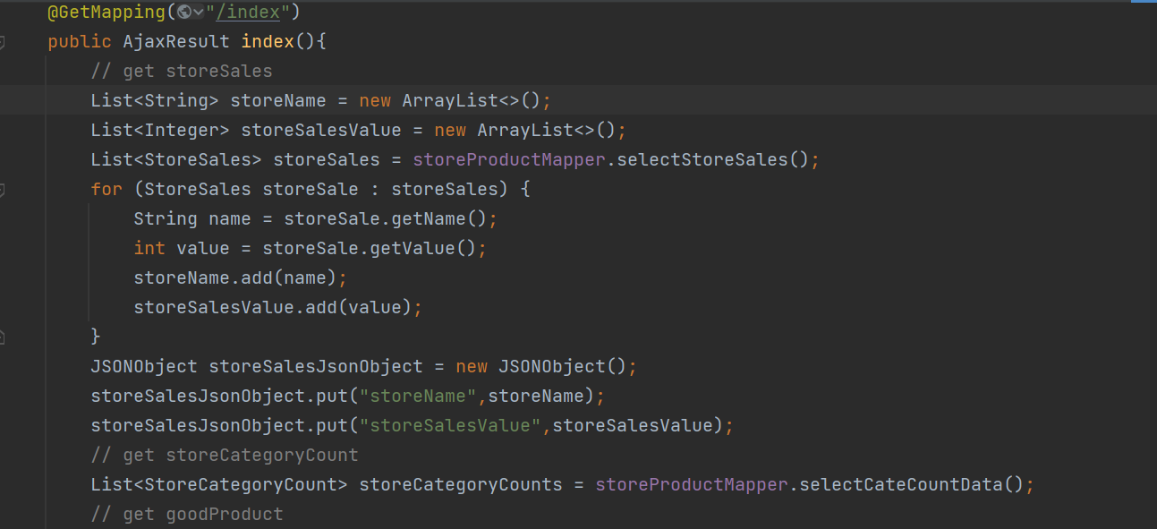
Counting the Number of Items Sold

Slide 19
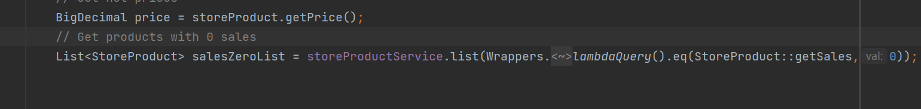
Statistics for items with 0 sales

Slide 20
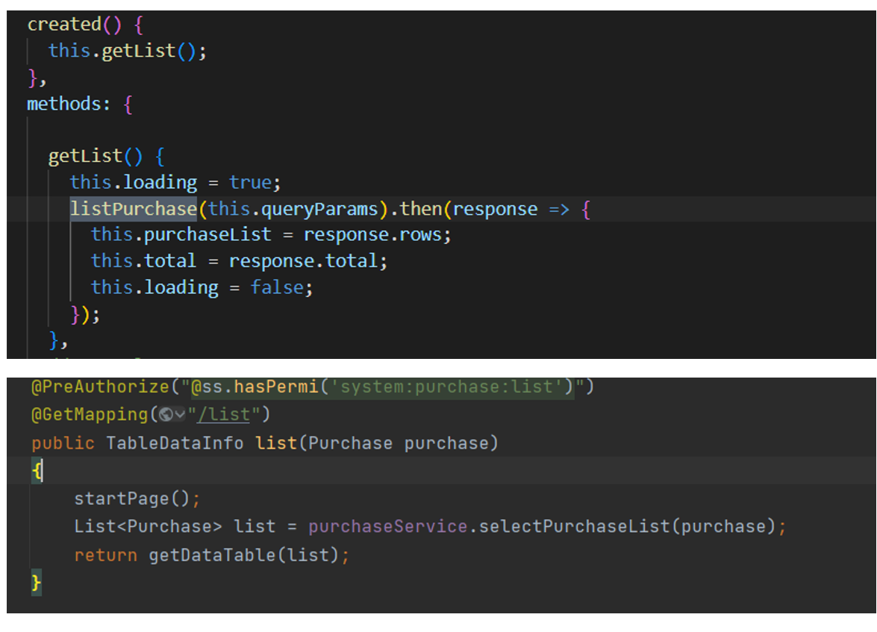
Query Item Information

Slide 21
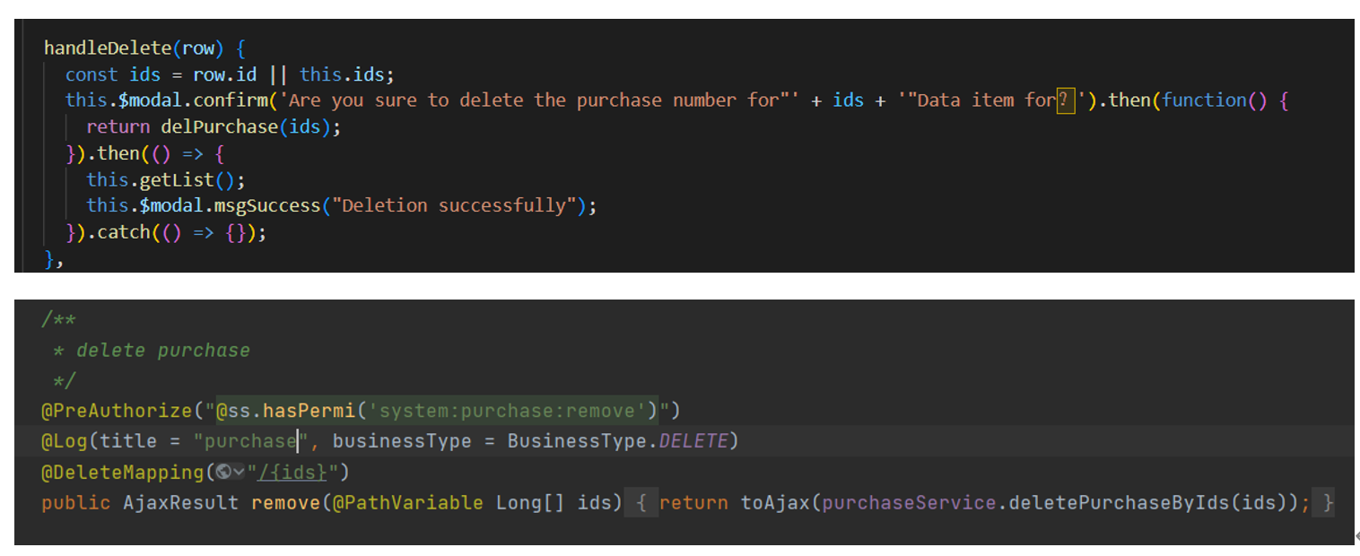
Delete Item Information

Slide 22
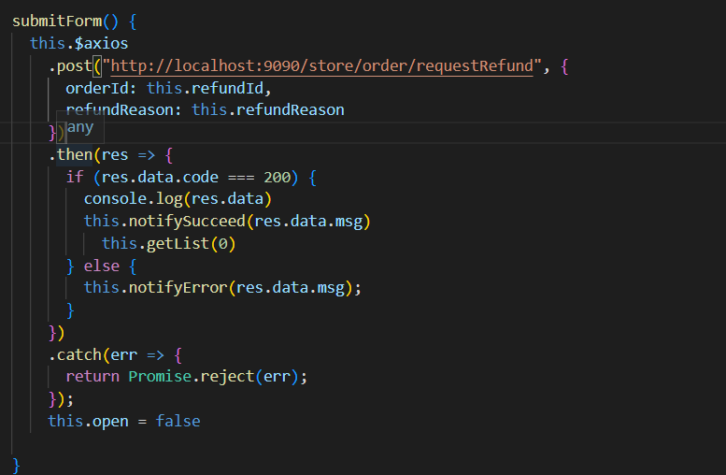
Return of Items

Slide 23
Conclusion
In summary, it can be said that the system has been developed through all phases of the project, allowing it to be built effectively and achieve the main objectives of the project. The proposed application has been implemented on a web-based platform and although it is not perfect, it has successfully met all the objectives and improved the user experience according to the feedback from participants who took part in the user acceptance tests.

Slide 24
Future Works
Future researchers could continue this project:
The system could be improved to be compatible with browsers for mobile or tablet devices
The system can be developed with a multilingual and multi-currency interface
The system's product upload process could be simplified
The system could be developed to support bulk export of shop data to devices in Excel file format

Slide 25
References
[1] Yin, Y., Zhang, R., Gao, H., & Xi, M. (2019). New retail business analysis and modeling: A Taobao case study. IEEE Transactions on Computational Social Systems, 6(5), 1126-1137.
[2] Wang, S., & Zhang, Y. (2015). The new retail economy of Shanghai. Growth and Change, 36(1), 41-73.
[3] Mou, S., Robb, D. J., & DeHoratius, N. (2018). Retail store operations: Literature review and research directions. European Journal of Operational Research, 265(2), 399-422.
[4] Luce, S. (2015). Revolutionizing Retail: Workers, Political Action, and Social Change by Kendra Coulter. Labour/Le Travail, 75(1), 265-266.
[5] Pulga, A., 2022. Introducing: iQmetrix Inside Sales. [online] Iqmetrix.com. Available at: <https://www.iqmetrix.com/blog/introducing-iqmetrix-inside-sales/>.

Slide 26
References (con’t)
[6] PAT RESEARCH: B2B Reviews, Buying Guides & Best Practices. 2022. Top 7 Retail Management Software in 2022 - Reviews, Features, Pricing, Comparison - PAT RESEARCH: B2B Reviews, Buying Guides & Best Practices. [online] Available at: <https://www.predictiveanalyticstoday.com/top-retail-management-software/>.
[7] Rahim, M. A., & Ara, R. Implementation of Point of Sale Software in Mobile Shop.
[8] Willems, K., Verhulst, N., & Brengman, M. (2021). How COVID-19 could accelerate the adoption of new retail technologies and enhance the (E-) servicescape. In The Future of Service Post-COVID-19 Pandemic, Volume 2 (pp. 103-134). Springer, Singapore.
[9] Ilias, J., Kasim, S., Hassan, R., Mahdin, H., Ramli, A. A., Fudzee, M. F. M., & Aizi, M. (2018). At-Thoyyib Shop Inventory Management System. Acta Informatica Malaysia (AIM), 2(2), 12-16.
[10] Tanamal, R., Nurdiansyah, Y., & Firdaus, F. (2020). Inventory Support System for Retail Shop. In E3S Web of Conferences (Vol. 188, p. 00020). EDP Sciences.

Slide 27

Thank you for watching

